Slide 1

Portfolio Website
Task - 2

Slide 2

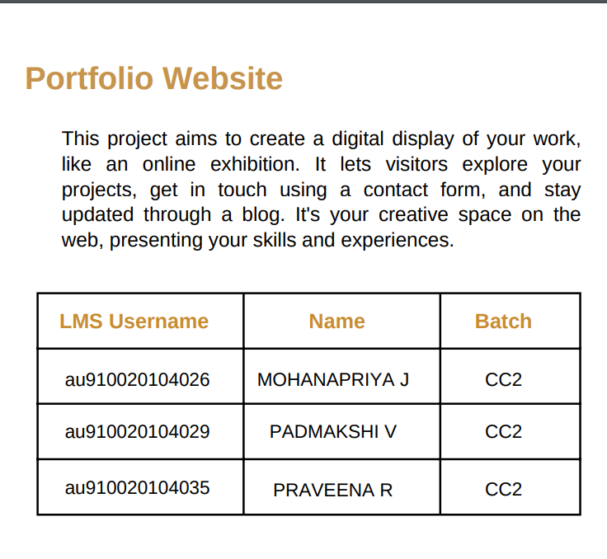

Slide 3

Task 2:
Objective:
Create the user interface (UI) and implement various components using React.
Tasks:
Component Structure:
Split design, define component structure, and implement Higher Order Components.
Basic UI Setup:
Set up UI components with dummy data for responsive design.
Rendering Data:
Render accurate and visually appealing content in various components.
User Interaction:
Implement interactive features for user engagement and smooth navigation.
Error Handling:
Implement robust error handling for potential frontend issues.
Security Measures:
Implement measures to secure the frontend and protect sensitive information.

Slide 4
Evaluation Metric:
Ensure 100% completion of UI components and responsive design.
Verify accurate rendering of content in various components for visual appeal.
Confirm successful implementation of interactive features for enhanced user engagement.
Learning Outcome:
Mastery in developing a complex UI using React components.
Proficiency in using props drilling and context to pass variables.
Experience in managing and presenting diverse input data effectively.
Skill in implementing interactive features for enhanced user experience.

Slide 5

Step-Wise Description:
Split design, define structure, implement Higher Order Components (HOC).
Set up UI components with dummy data for responsiveness.
Render accurate and visually appealing content.
Implement interactive features for smooth navigation.
Implement robust error handling for frontend issues.
Integrate security measures to protect sensitive information.
Summary of Your Task:
Develop a dynamic React-based UI for a portfolio, ensuring responsiveness and interactivity.

Slide 6
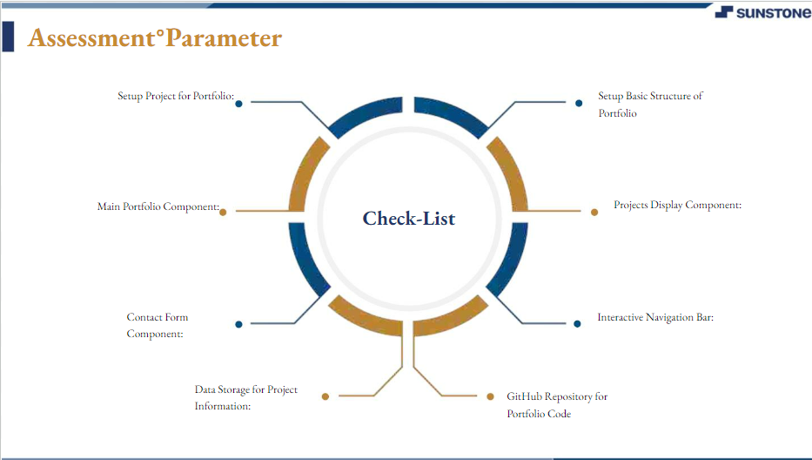

Slide 7

Submission Github
Click for github link

Slide 8


